Slide 1
Introduction
A simple variable can store one value at a time. An array can store a number of variables of the same type. For example, marks obtained by a student in five subjects can be stored in an array marks[5]. marks[0], marks[1], etc, will store student information like the marks obtained in various subjects. Suppose we want to store student information in array name, htno, address,marks obtained. We cannot store this information in an array because name, htno, address are of character type and marks obtained is of integer type. So arrays are used to store homogeneous data. To store heterogeneous data elements in a single group, C language provides a facility called the structure.

Slide 2
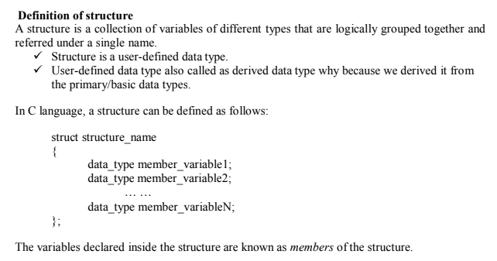
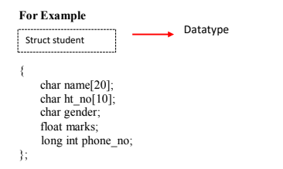

Slide 3
Points remember
✓ The members of the structure may be any of the common data type, pointers, arrays or even the other structures.
✓ Member names with in a structure must be different.
✓ Structure definition starts with the open brace({) and ends with closing brace(}) followed by a semicolon.
✓ The compiler does not reserve any memory when structure is defined. We have to define the variable to store its information.

Slide 4
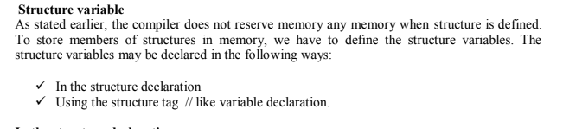
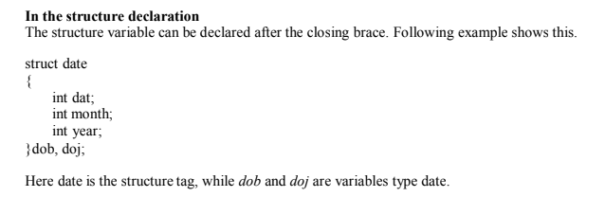

Slide 5
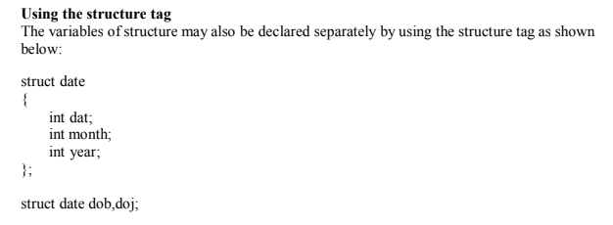

Slide 6
Initialization of structure
We can initialize the values to the members of the structure as:
struct structure_name structure_variable={value1, value2, ... , valueN};
✓ There is a one-to-one correspondence between the members and their initializing values.
✓ C does not allow the initialization of individual structure members within the
structure definition template.
struct date
{
int dat;
int month;
int year;
};
struct date dob={25,12,1998}; or ={.month=9,.year=2019,.dat=19};

Slide 7
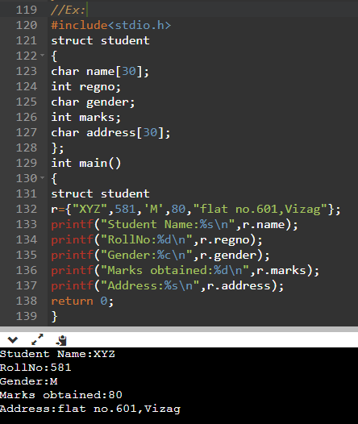

Slide 8
Accessing members of structure
For accessing any member of the structure, we use dot (.) operator or period operator. We can also use operator also. when we are accessing structure members through pointers then we use arrow operator.
Syntax:
structure_variable.membername
Here, structure_variable refers to the name of a structure type variable and member refers to the name of a member within the structure.

Slide 9
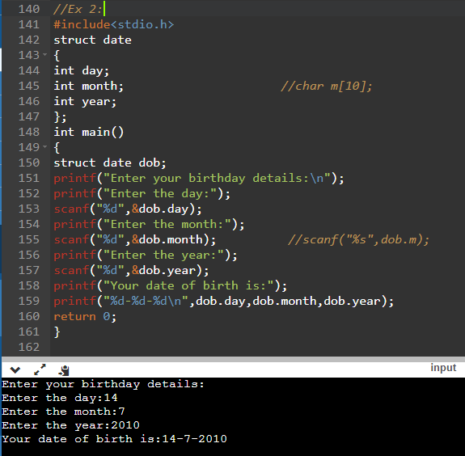

Slide 10
Nested Structure
We can take any structure as a member of structure. i.e. called structure with in structure or nested structure.
For example:
struct
{
member 1;
member 2;
... ...
... ...
struct
{
member 1;
member 2;
}s_var2;
... ...
member m;
}s_var1;
For accessing the member 1 of inner structure we write as:
s_var1.s_var2.member1;

Slide 11
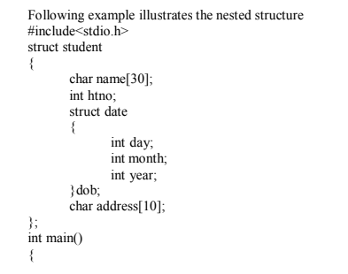

Slide 12
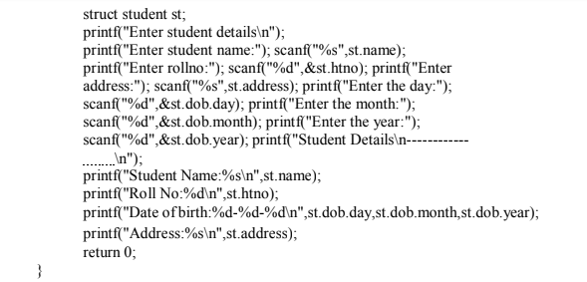

Slide 13
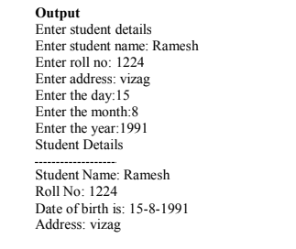

Slide 14
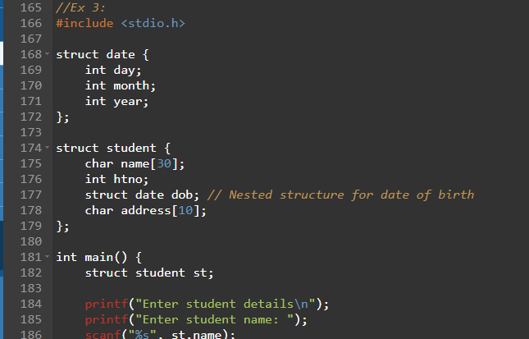
or

Slide 15
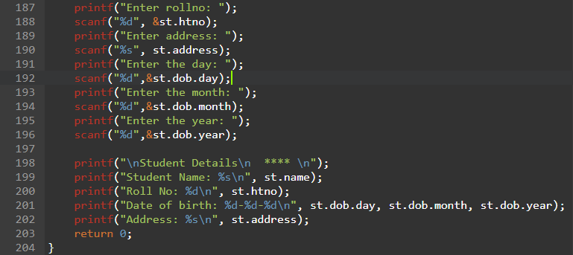

Slide 16
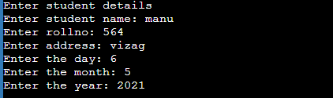
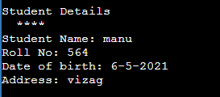

Slide 17
Array of structures :
An array of structures is declared in the same way as we declare an array of a predefined data type.
Syntax :
struct struct_name
{
data_type member;
.....................
.......................
.......................
}
struct struct_name struct_var[index];

Slide 18
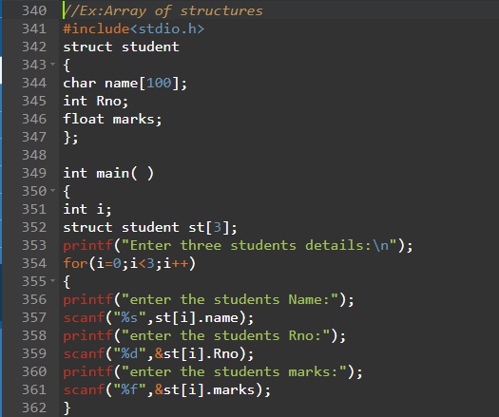

Slide 19
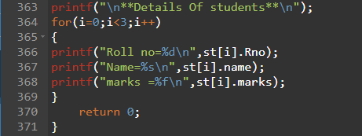
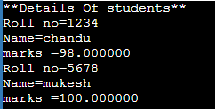
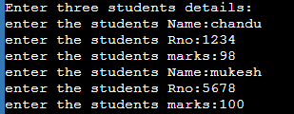

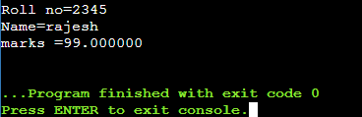

Slide 20
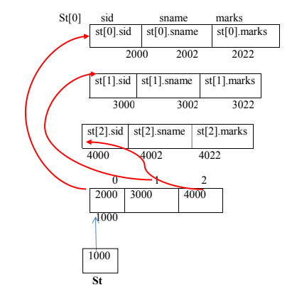

Slide 21
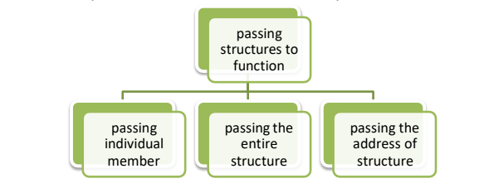
Structures to Functions:-
→ A function may access the members of a structure in three ways.
1.Passing individual member:
→ To pass any individual members of the structure to a function we must use the direct selection operator to refer to the individual member for the actual parameters.
→ The called function does not know it the two variable are ordinary variable or structure member.

Slide 22
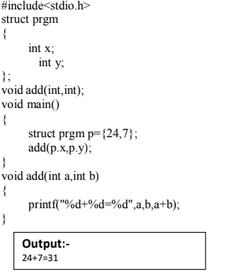

Slide 23
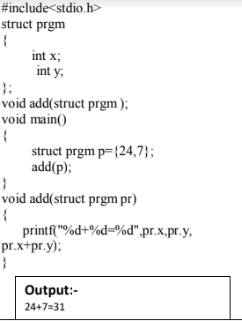
2.Passing entire structure :
→ We can pass an entire structure as a function argument when a structure is passed as an
argument. It is using call by value method.
→ A copy of each member of structure is made. This is a very complicated especially when
structure is very big or the function is called frequently.
→ In such a situation passing and working with pointers may be more efficient.

Slide 24
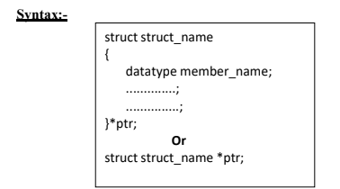
3.Passing structures through pointers (pointers to structures):-
→ Passing large structures to function using the call by value method is very inefficient.
→ It is professional to run structure through pointer.
→ It is possible to create a pointer to almost any type in C ,including user defined types

Slide 25
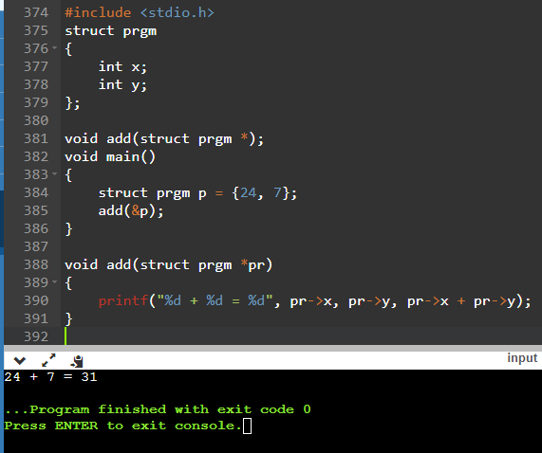

Slide 26

SELF-REFERENTIAL STRUCTURES:
• Self-referential structures are those structures that have one or more pointers which point to the same type of structure, as their member.
• In other words, structures pointing to the same type of structures are self-referential in nature.
• A self-referential structure is used to create data structures like linked lists, stacks, etc.
Syntax:
struct struct_name
{
datatype datatypename;
struct_name *pointer_name;
};
Self-referential Structure with Single Link: These structures can have only one self-pointer as their member. The following example will show us how to connect the objects of a self-referential structure with the single link and access the corresponding data members. The connection formed is shown in the following figure.

Slide 27
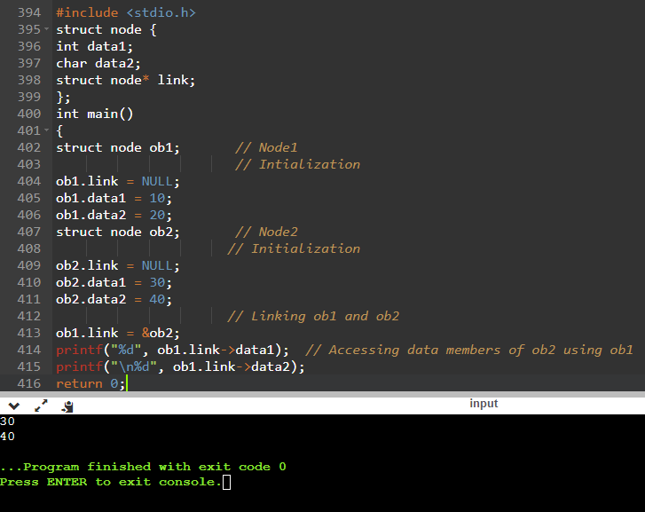

Slide 28
UNIONS:
A union is a special data type available in C that allows to store different data types in the same memory location. You can define a union with many members, but only one member can contain a value at any given time. Unions provide an efficient way of using the same memory location for multiple-purpose.
Defining a Union:
To define a union, you must use the union statement in the same way as you did while defining a structure. The union statement defines a new data type with more than one member for your program.
Syntax:
union [union tag]
{
member definition; member definition;
…….
member definition;
};

Slide 29
The union tag is optional and each member definition is a normal variable definition, such as int i; or float f; or any other valid variable definition. At the end of the union's definition, before the final semicolon, you can specify one or more union variables but it is optional.
Example:
union Employee
{
int eno;
char name[20];
float salary;
};
Accessing Union Members:
To access any member of a union, we use the member access operator (.). The member access operator is coded as a period between the union variable name and the union member that we wish to access.

Slide 30
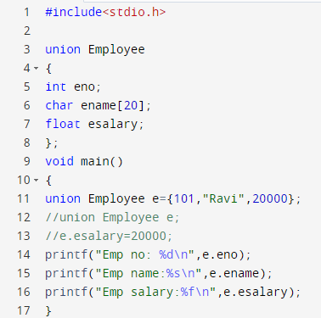
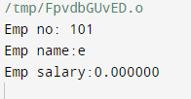

Slide 31
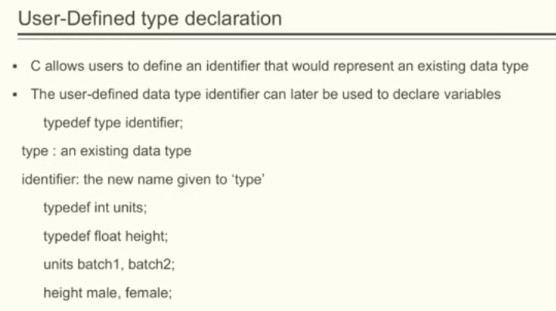

Slide 32
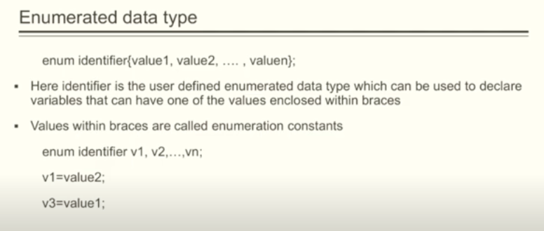

Slide 33
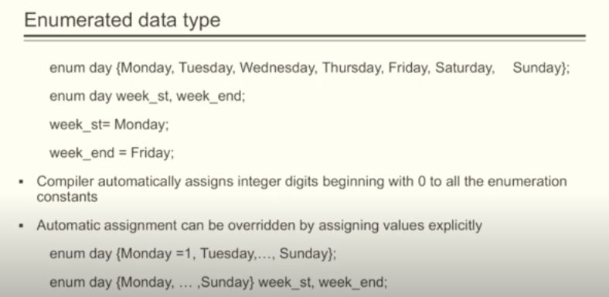

Slide 34
typedef in C
The typedef is a keyword used in C programming to provide some meaningful names to the already existing variable in the C program. It behaves similarly as we define the alias for the commands. In short, we can say that this keyword is used to redefine the name of an already existing variable.
Syntax
typedef <existing_name> <alias_name> ;
In the above syntax, 'existing_name' is the name of an already existing variable while 'alias name' is another name given to the existing variable.
Example:
void main()
{
typedef int cse;
cse a=5,b=6,c;
c=a+b;
printf("%d",c);
getch();
}

Slide 35
Enumerated Data type:-
➢ User defined data type based on standard integer.
➢ Working with a set of elements using constant integer values.
➢ The functionality of a particular element we are accessing just with help of constant integer value called as enum.
➢ It contains set of named integer constant. Each integer value is assigned an identifier.
➢ It provide symbolic name to make the program more readable.
Syntax:-
enum enumeration_name {identifier1,------ , identifier n};
➢ The enum keyword basically used to declare and initialize a sequence of integer
constants. Here enumeration name is optional.
Ex:-
enum E1CSE{CSE1, CSE2, CSE3, CSE4, CSE5}; output : 1,2,3,4,5
enum E1CSE{CSE1=2, CSE2, CSE3=10, CSE4, CSE5=24}; output : 2,3,10,11,24

Slide 36

Ex:-
#include<stdio.h>
int main()
{
enum E1CSE{CSE1=2, CSE2, CSE3=10, CSE4, CSE5=24};
printf(“\n CSE1=%d”,CSE1);
printf(“\n CSE2=%d”,CSE2);
printf(“\n CSE3=%d”,CSE3);
prinnf(“\n CSE4=%d”,CSE4);
prinnf(“\n CSE5=%d”,CSE5);
return 0;
}

Slide 37
Bit Fields in C
In C, we can specify the size (in bits) of the structure and union members. The idea of bit-field is to use memory efficiently when we know that the value of a field or group of fields will never exceed a limit or is within a small range. C Bit fields are used when the storage of our program is limited.
Need of Bit Fields in C
Reduces memory consumption.
To make our program more efficient and flexible.
Easy to Implement.
Syntax of C Bit Fields
struct { data_type member_name : width_of_bit-field; };
where,
data_type: It is an integer type that determines the bit-field value which is to be interpreted. The type may be int, signed int, or unsigned int.
member_name: The member name is the name of the bit field.
width_of_bit-field: The number of bits in the bit-field. The width must be less than or equal to the bit width of the specified type.

Slide 38

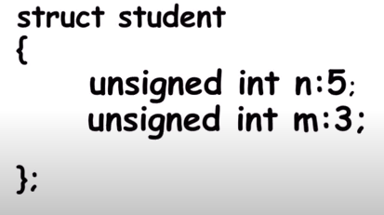
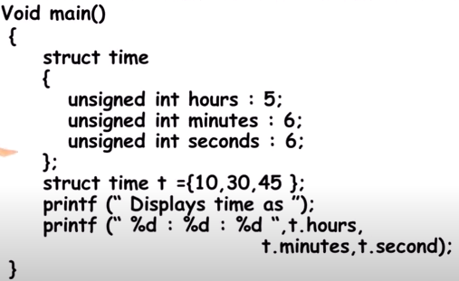

Ex:

Slide 39
FILES
In C programming, file is a place on your physical disk where information is stored.
WHY FILES ARE NEEDED?
• When a program is terminated, the entire data is lost. Storing in a file will preserve your data even if the program terminates.
• If you have to enter a large number of data, it will take a lot of time to enter them all. However, if you have a file containing all the data, you can easily access the contents of the file using few commands in C.
• You can easily move your data from one computer to another without any changes.
TYPES OF FILES:
When dealing with files, there are two types of files you should know about:
• Text files
• Binary files
Text files:
• Text files are the normal .txt files that you can easily create using Notepad or any simple text editors.
• When you open those files, you'll see all the contents within the file as plain text. You can easily edit or delete the contents.
• They take minimum effort to maintain, are easily readable, and provide least security and takes bigger storage space.
Binary files:
• Binary files are mostly the .bin files in your computer.
• Instead of storing data in plain text, they store it in the binary form (0's and 1's).
• They can hold higher amount of data, are not readable easily and provides a better security than text files.

Slide 40
C provides a number of functions that helps to perform basic file operations. Following are the functions,
Function description
fopen() create a new file or open a existing file
fclose() closes a file
getc() reads a character from a file
putc() writes a character to a file
fscanf() reads a set of data from a file
fprintf() writes a set of data to a file
getw() reads a integer from a file
putw() writes a integer to a file
fseek() set the position to desire point
ftell() gives current position in the file
rewind() s et the position to the begining point

Slide 41
FILE OPERATIONS:
In C, you can perform four major operations on the file, either text or binary:
• Creating a new file
• Opening an existing file
• Closing a file
• Reading from and writing information to a file
DECLARATION:
When working with files, you need to declare a pointer of type file. This declaration is needed for communication between the file and program.
FILE *fptr;
OPENING A FILE:
Opening a file is performed using the library function in the "stdio.h" header file: fopen().
Syntax:
fptr=fopen(“filename/path”, “mode”);
Examples:
fopen("E:\\cprogram\\newprogram.txt","w");
fopen("file1.txt","w");
• Let's suppose the file newprogram.txt doesn't exist in the location E:\cprogram. The first function creates a new file named newprogram.txt and opens it for writing as per the mode 'w'.The writing mode allows you to create and edit (overwrite) the contents of the file.
CLOSING A FILE:
The file (both text and binary) should be closed after reading/writing.Closing a file is performed using library function fclose().
Syntax:
fclose(fptr); //fptr is the file pointer associated with file to be closed.

Slide 42
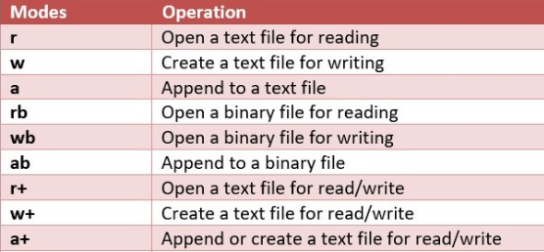

Slide 43
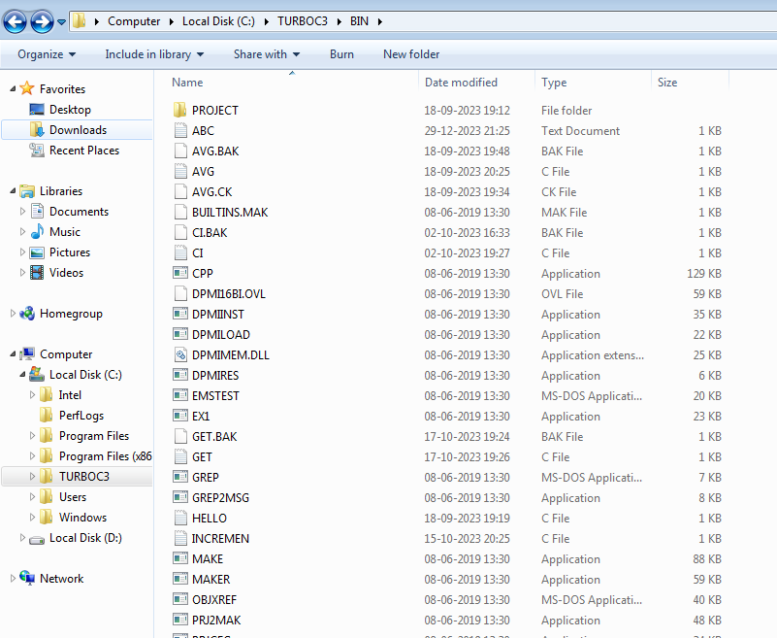

Slide 44
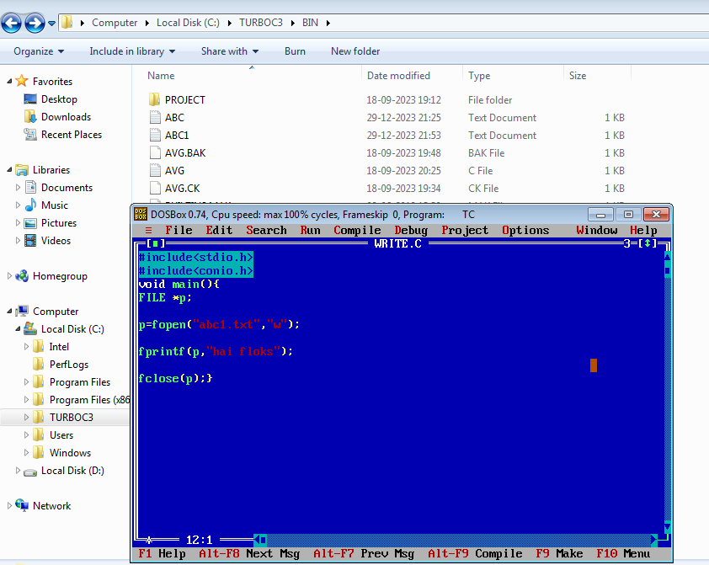

Slide 45
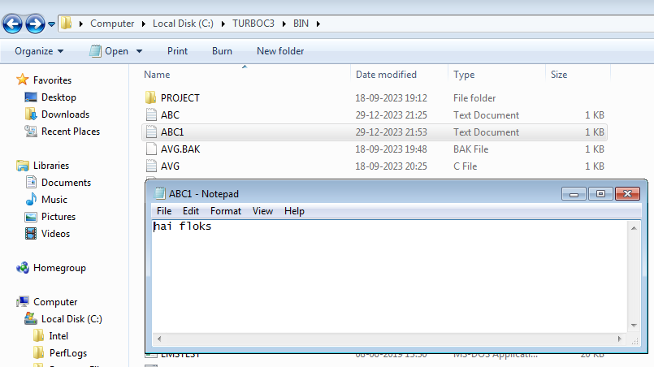

Slide 46
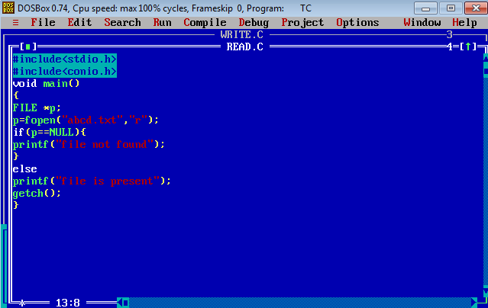
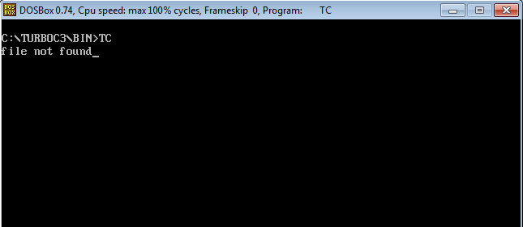

Slide 47
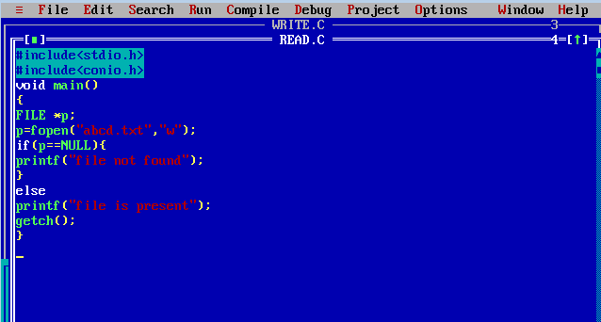
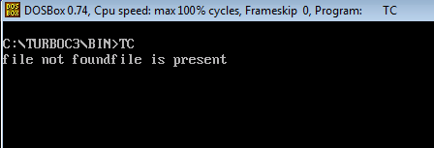

Slide 48
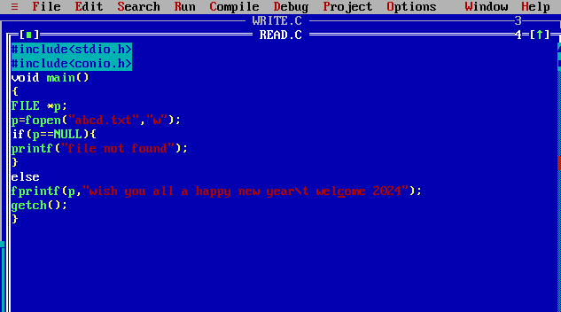

Slide 49
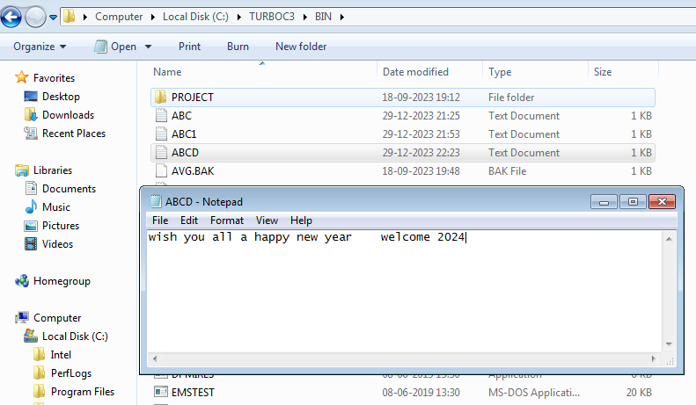

Slide 50
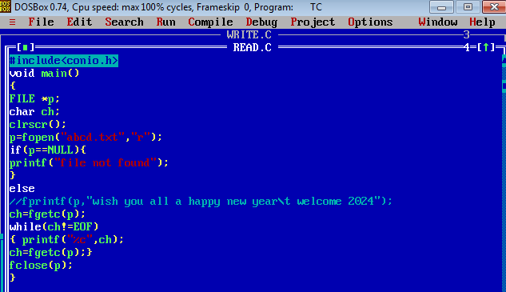
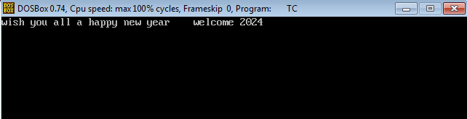

Slide 51
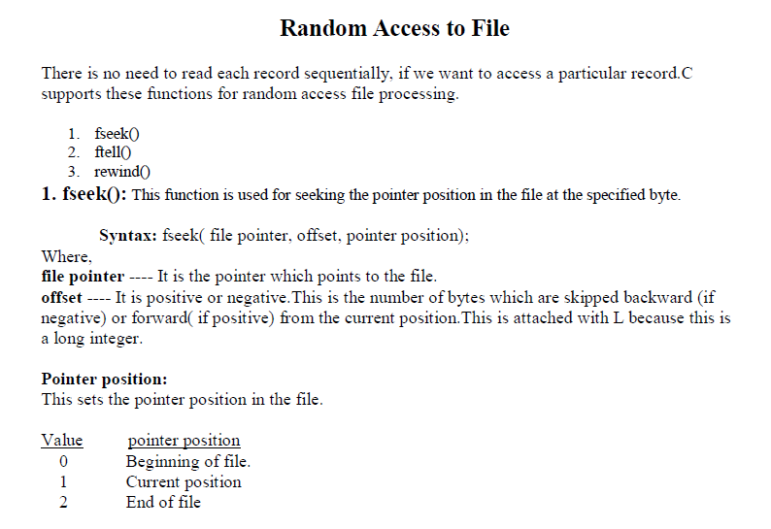

Slide 52
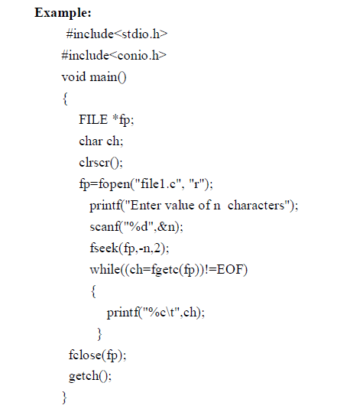

Slide 53
ftell():
This function returns the value of the current pointer position in the file. The value is count from the beginning of the file.
Syntax: ftell(fptr); Where fptr is a file pointer.
rewind():
This function is used to move the file pointer to the beginning of the given file.
Syntax: rewind( fptr); // Where fptr is a file pointer.
Example:
#include<stdio.h>
#include<conio.h>
void main()
{
FILE *fp;
char ch;
int n;
fp=fopen("file1.c", "r");
n=ftell(fp);
printf(“Current position: %d”,n);
rewind(fp);
printf(“Current position: %d”,ftell(fp));
fclose(fp);
getch();
}

